Slide 1
National e-Invoicing Initiative: Beyond Compliance, Driving Efficiency & Transparency
1
Date: 20 Aug 2025
SAGA Government Agency Conference 2025 (SeGAC)

Slide 2

Common Misconception
2
"E-Invoicing is just for tax compliance."
  Reality: True e-invoicing goes beyond just sending invoices to tax authority (LHDNM). It enable businesses to send and receive invoices digitally with other businesses without human intervention.
  This opens up opportunities to digitalise business processes and drive automation. It also sets the foundation for data-driven and AI-powered insights, enabling smarter business decisions and future-ready operations.
Why Agencies & Businesses Should Care Beyond Tax Compliance?

Slide 3
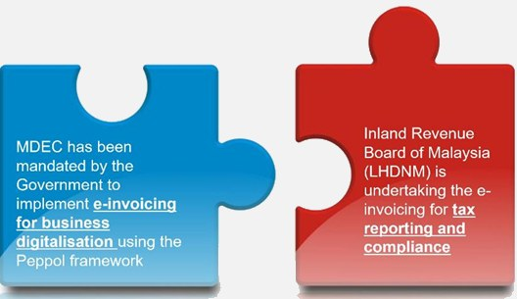
How E-Invoicing is Implemented in Malaysia
In Malaysia, e-Invoicing is being implemented with two distinct yet complementing components:
3
MDEC’s initiative:
Digitalise and automate the exchange of e-invoice between businesses.
When businesses adopt e-invoicing for business digitalisation, they also fulfill e-invoicing for tax compliance as well.
LHDNM’s initiative:
Require businesses (i.e. supplier) to submit their e-invoice to LHDNM to be validated.
Mandatory implementation starting 1 Aug 2024 for businesses with revenue/sales >RM100million
The e-invoicing implemented by MDEC and LHDNM completes the e-invoicing ecosystem in the country.

Slide 4
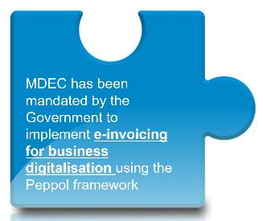

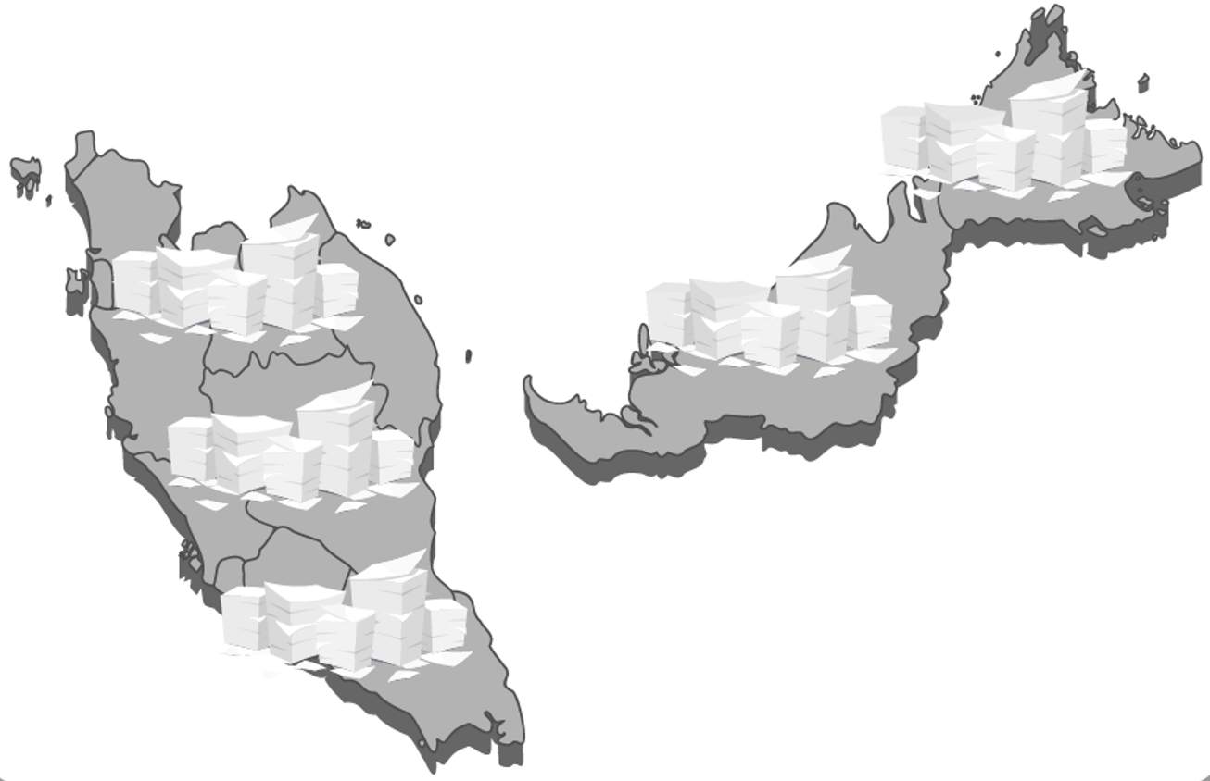

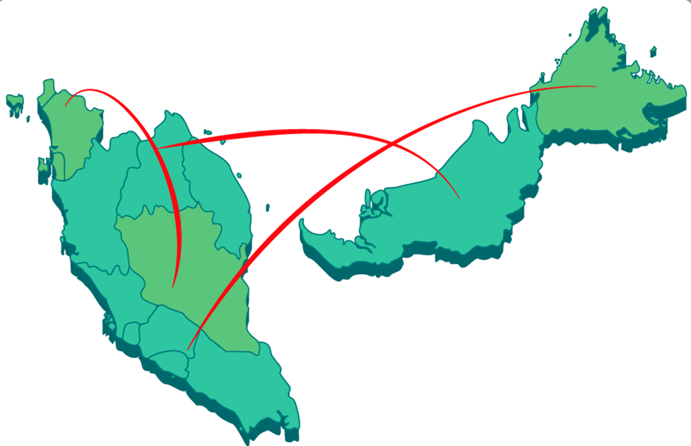

E-Invoicing for Business Digitalisation by MDEC
Enabling Digital Transactions for Seamless Domestic and Global Trade
4
4
OBJECTIVE
Aims to drive interoperable E-Invoicing, enabling businesses to exchange e-invoices and documents in a system-to-system manner with other businesses, regardless of hardware and software used.
THE ASPIRATION
Digitally transforming businesses in Malaysia from traditional paper and PDF based invoice exchange to a fully automated system-to-system data exchange i.e. interoperable e-invoicing.
Current State
Future State
Business process digitalization - paperless!
Manual and paper-based business operations
Problem Statement:
Paper/PDF invoice/document processing still common practice in Malaysia
Challenges: manual data entry, labour intensive, time-consuming, error-prone, payment delay, no traceability etc
Interoperability for seamless cross border transaction
Solution:
Digital transformation of businesses from paper/PDF base e-invoice and document processing to an automated system-to-system data transfer
Interoperability at domestic and global level.
To achieve interoperability for system-to-system data transfer, an interoperable framework was introduced to standardize the specification and message format using the Peppol framework.

Slide 5
What is Peppol?
Peppol is not a platform or system.
It is a set of technical specifications that standardize the way information is structured and exchanged.
Why Peppol was chosen?
Established and proven: Peppol is the most widely used e-Invoicing framework in the world, currently used in >23 countries:
Enables interoperability at domestic and global level
Fast to market – Localise to Malaysia requirement
UK, Belgium, Denmark, Norway, Sweden, Poland, Italy, Singapore, Netherlands, Ireland, Germany, Austria, Australia, New Zealand, Iceland, Portugal, Japan, Finland, Malaysia, Slovakia, France, UAE

Slide 6
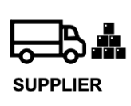



How does it work?
Interoperable E-Invoicing for Business Digitalisation - Automating E-Invoice Distribution (B2B) and Tax Reporting
6
Business Digitalisation
Interoperable E-Invoice Distribution
Tax Reporting & Compliance
E-invoice for tax reporting - Businesses submit e-invoices to LHDNM for tax compliance via Accredited Peppol Service Provider.
E-invoice distribution - Sharing of e-invoice between businesses is via the Peppol network or email, depending on corner 4 (buyer) readiness.
1
2
Peppol-Ready Solution Provider (PRSP)
Issuance of
e-Invoice​
Peppol Service Provider (SP)
Submit e-Invoice for validation​
Accounting/ERP System
Validated
e-Invoice​
Access Point
Return validated e-Invoice
4
Validated
e-Invoice​
3
4
API
Email PDF or other
methods
No
Buyer
With Peppol ID
Yes
Peppol-Ready Solution Provider (PRSP)
5
Validation of
e-Invoice​
Peppol Service Provider (SP)
Validated
e-Invoice​
Accounting/ERP System
Access Point
Businesses can send and receive e-invoices with other businesses, regardless of accounting software or ERP system used – interoperable e-invoicing!
Peppol Service Provider (SP) - Functions as Access Point that connects to the Peppol Network.and to LHDNM system.
Peppol-Ready Solution Provider (PRSP ) - Accounting software / ERP system / platforms that provides the functionality of sending and receiving of e-Invoice via Peppol network.

Slide 7
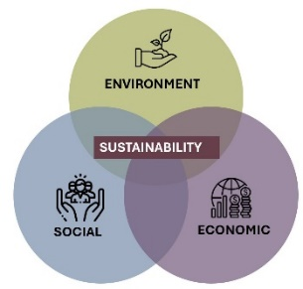

Benefits of E-invoicing for Business Digitalisation
Automating E-Invoice Distribution (B2B) and Tax Reporting
7
7
Benefits to Businesses
Economic and Societal Impact to Country
INCREASED BUSINESS EFFICIENCY
  Faster processing time - 90% reduction in time for AR/AP
REDUCE OPERATIONAL COST
  Lower manpower requirement
  Reduces cost on paper, printing, postage, storage > 60% reduction of processing cost
ENHANCE SECURITY
  Reduce the risk of fraudulent bills
EASE CROSS BORDER TRANSACTIONS
  Improve cross border data exchange on business transactions
‘GREENER’ FOR BUSINESS (ESG)
  Reducing paper-based invoicing reduces carbon footprint
SUPPORT TAX COMPLIANCE
  Easier for businesses to submit e-invoice to LHDNM
DIGITAL TRANSFORMATION
  Improved Malaysia businesses’ competitiveness
  Enables businesses in Malaysia to participate in a globally interconnected digital economy, especially for cross-border trade.
FREE TRADE AGREEMENT (FTAs)
  Fulfill Malaysia’s commitment in various FTAs where interoperable e-invoicing is one of the committed obligations.
FOUNDATION FOR DIGITAL AND CROSS-BORDER TRADE
  Provides foundation for digital and cross-border trade
  Enables seamless digital transactions, not just within the country but globally.
SUSTAINABILITY
  Environmental benefits – Reduce national carbon footprint

Slide 8

Why Gov Agencies & Businesses Should Care Beyond Tax Compliance?
8
Boosts transparency and auditability -Strong audit trails, easier compliance checks, and reduced fraud risk.
Compliance is just the start – The real gains are in efficiency & growth.
Support Digital Government Goals – Align with MYDIGITAL and ESG commitments through paperless processes and greener operations.
Future-Ready – Builds a foundation for data-driven decision-making, AI insights
Notes:
If you implement e-invoicing to comply to tax compliance only:
How do you recover your implementation and operating cost of e-invoicing?
Is your business process easier or more steps after implementation?

Slide 9
Future Outlook
Global Trend
Interoperable e-invoicing is a global trend.
Many countries are adopting Peppol framework to enable seamless cross border digital trade.
Examples of Peppol E-invoicing Implemented in Other Countries for B2G*
Australia (Aug 2024)
124 federal and 272 state government agencies enabled to receive e-invoices in Peppol format, with 5 days payment times
Malaysia’s Direction
Government promotes Peppol framework e-invoicing for domestic & international interoperability
Long term plan: Digitalise other business documents such as Sales/Purchase Order, Delivery Notes and others
New Zealand (Sept 2024)
40 government agencies enabled to receive e-invoices in Peppol format
“Early adoption brings greater efficiency, transparency & future benefits”
*Source: Australia Tax Office (Peppol Authority for Australia) and Ministry of Business Innovation and Employment (Peppol Authority for New Zealand)
Notes:
Interoperable e-invoicing is a global trend – it is part of many Free Trade Agreements (FTAs) and framework of cooperation between countries to ease cross border digital trade.
At national level, the Government (via three national-level roadmap/blueprint) is advocating digital transformation via e-invoicing using Peppol framework for interoperability at domestic and international level

Slide 10

Call for Action
What You Should Do Now?
10
10
See it as a growth tool, not a compliance burden
Explore and plan integration with your current SAGA compliance solutions
Think long term, start small, scale up strategically

Slide 11
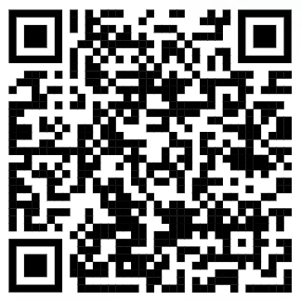
Contact Us
11
For more information on the E-Invoicing for business digitalisation:
Please visit https://mdec.my/national-einvoicing or scan the QR code below for any inquiries :
For any queries on e-Invoicing using the Peppol framework, please email to clic@mdec.com.my

Slide 12
12

Slide 13























































Service Providers (SP) and Peppol-Ready Solution Providers (PRSP) Accredited by MDEC
SP
+ many more
PRSP
+ many more
Accreditation is an on-going process. More service providers are coming.
For the latest list of accredited SPs and PRSPs, or how to become an SP / PRSP, please visit: https://mdec.my/national-einvoicing

Slide 14
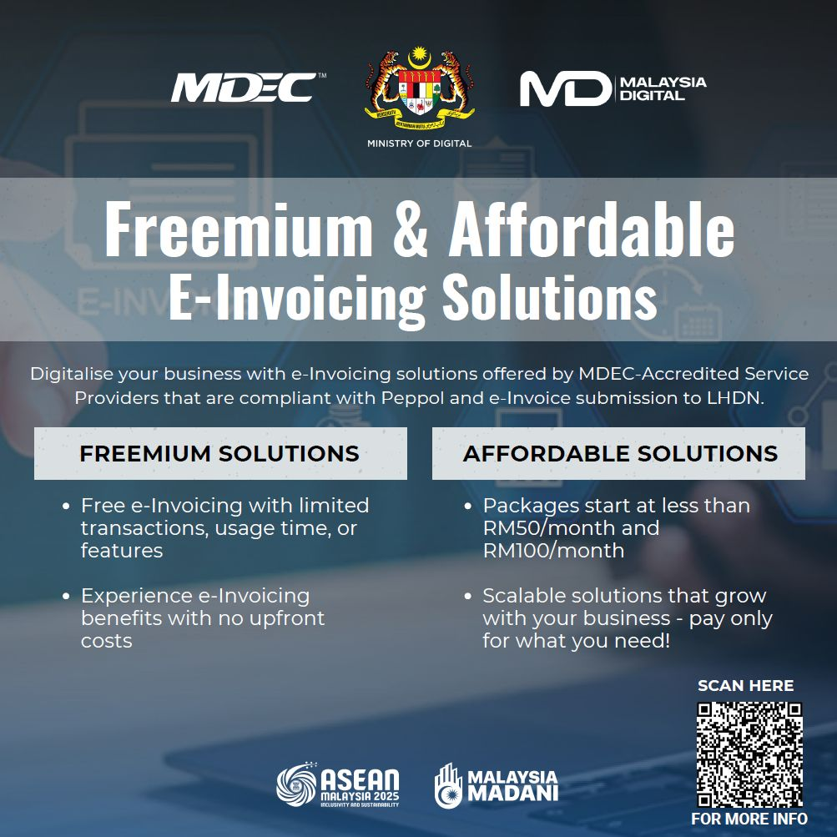
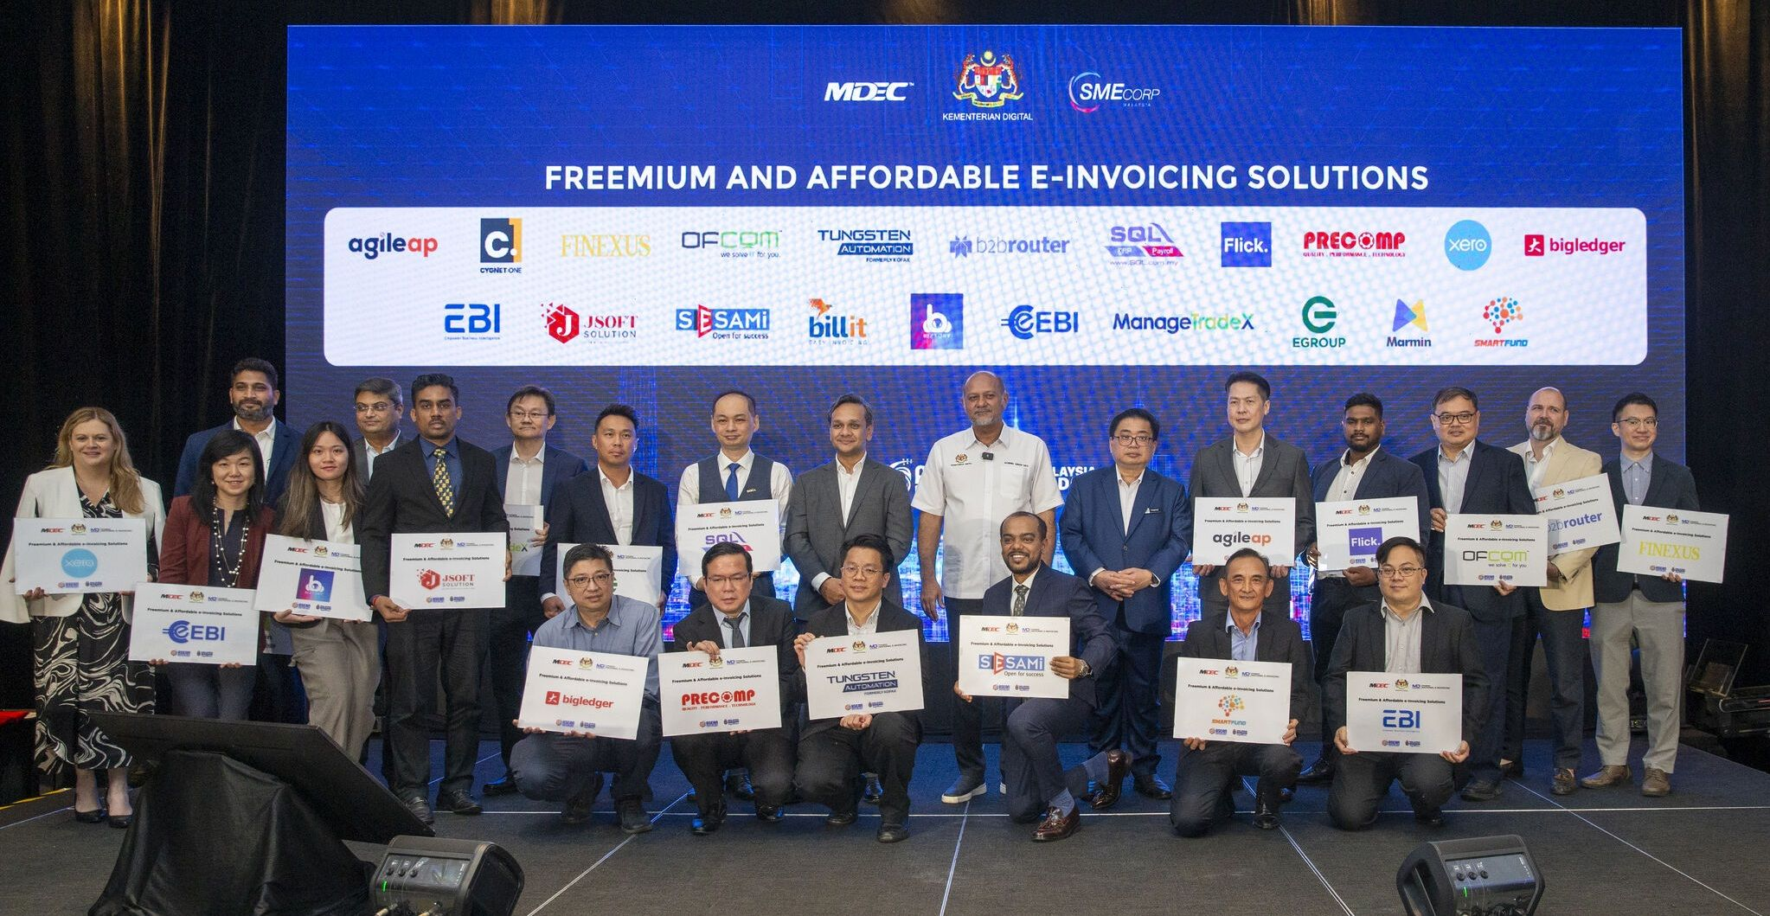
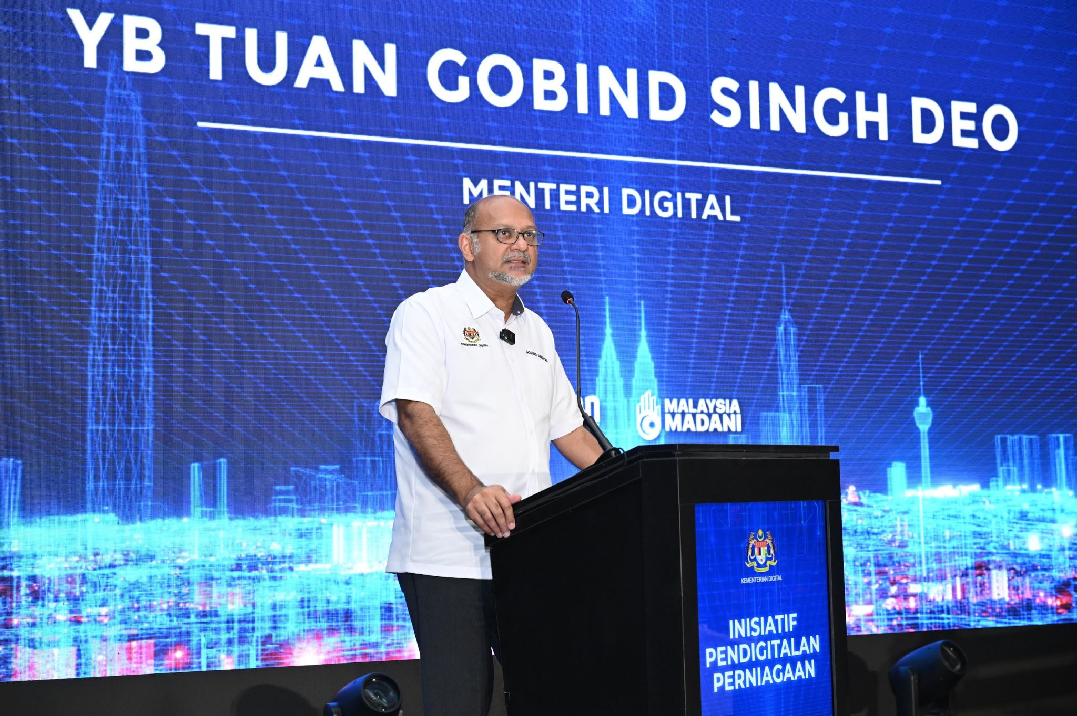
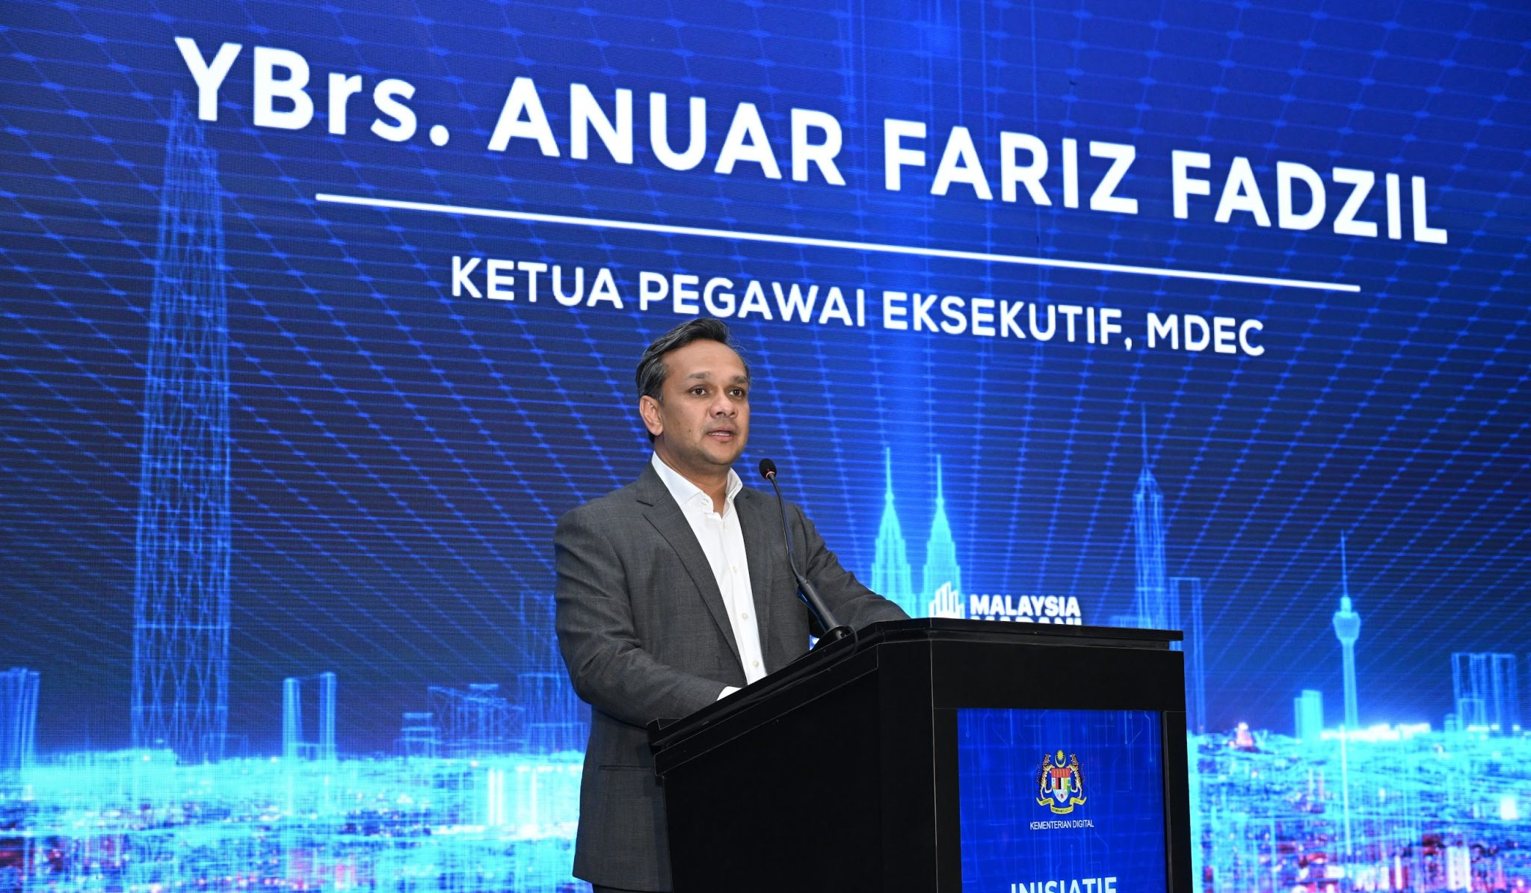
E-Invoicing for All
Feedback:
  MSMEs - often cited that cost of e-invoicing a key barrier.
  Large Business – concerns that their MSME vendors may not be ready or connected to Peppol network.
Actions Taken:
  MDEC is working with accredited e-invoicing service providers to address these issues.
  The Minister of Digital announced Freemium & Affordable E-Invoicing Solutions to support adoption.
Service Providers are welcome to participate in this program.
  https://mdec.my/national-einvoicing/freemium-and-affordable-solutions

