Slide 1
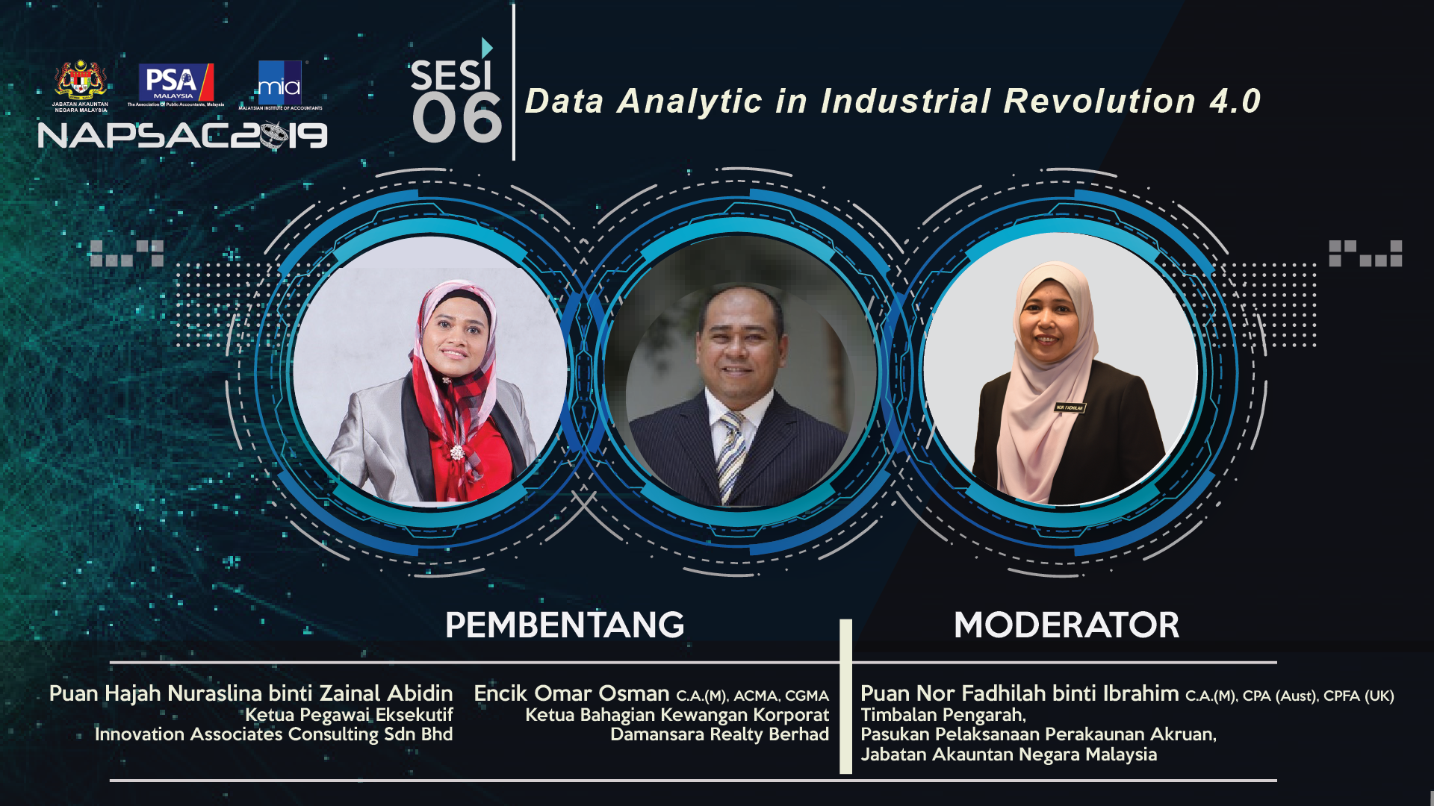


Slide 2
Innovation Associates Consulting
New Breed in Technology
Consulting

Slide 3
Data Analytics in IR4.0
Financial System Using AI & Big Data Analytics
Nuraslina Zainal Abidin
Chief Executive Officer
Innovation Associates Consulting Sdn Bhd
19 September 2019

Slide 4


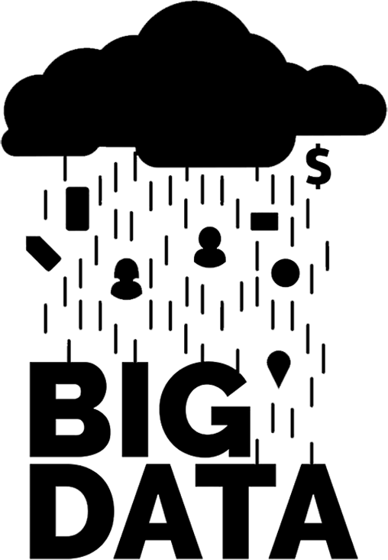






How Big Data & AI impact our life?
Every 1 minute, we
send 16 million text messages
200 Billion
IoT devices by 2020
2.5 Quintillion (10¹⁸) Byte of Data Created everyday
$17 billion credit card transaction per-day
600m Insta
users every day
300mil photos
updated on FB everyday
3.7 Billion humans
use internet every day
9 Billion email
users by 2019
5 Billion Google Search every day

Slide 5
How Big Data & AI impact our life?
49%
85%
By 2020, the average person will have more conversations with bots than with their spouse
Source: Gartner
of all activities people are paid to do today have the potential to be automated by adapting currently demonstrated technology.
Source: McKinsey
of a businesses’ customer relationships will be managed by virtual assistants by 2020
Source: Gartner

Slide 6
“Information is the oil of the 21st century, and analytics is the
combustion engine.”
Peter Sondergaard, Senior Vice President, Gartner

Slide 7
Big Data Analytics & AI will help us to make a better decision
Government Making
Better Decision
Artificial
Intelligence
NLP
Prescriptive
Predictive
Machine Learning
Big Data Analytics
Urban Observatory
Data Formatting
Data Cleansing
Data Regulatory Framework
Data
Ownership
Aggregation
Data Security
Data Conversion
Multiple Agencies Data
IOT Devices – Social Media – ERP – Mobile Apps

Slide 8
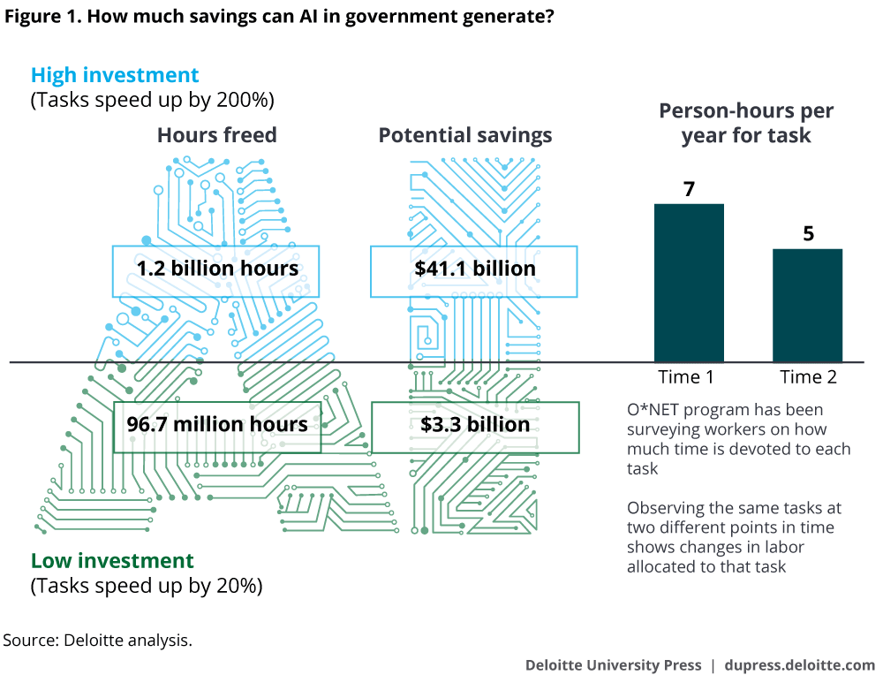
How much saving can AI generate in Government ?

Slide 9








Case Study (MySAGA Project)
Cloud Accounting: Digital Transformation of Standard Accounting for Government Agencies (SAGA)
Cloud solution
Subscription base
User personalisation
Online workflow
Easy electronic payment and statements
Disaster recovery assistance
Offsite data storage
Lower cost of ownership
Applied by:

Slide 10









Big Data Analytics & Blockchain to prevent fraud
Fraud pattern
is formed
Any deviations are detected.
Transaction
is blocked
Benefits
More
accurate
prediction
Better
decision
making
Real-time
tracking
Improved resource allocation
Increased
effectiveness
Anomally
detection

Slide 11
Workshop – AI Readiness Assessment
Integrated Transformation Roadmap
AI readiness impact analysis
Derive the value of digital transformation
Customer Experience
Process & System
Change Impact Assessment and Benefit Realization
Digital
Transformation
Talent & Organization
Product Innovation
Initiative Prioritization Framework

Slide 12
Innovation Associates Consulting Sdn Bhd
Tower 3 Avenue 5,
The Horizon Bangsar South,
No. 8 Jalan Kerinchi,
59200 Kuala Lumpur,
Malaysia.
www.theiac.com
If you have any inquiries on our services, kindly email to
enquiries@theiac.com

